Slide 1

High Speedy
Space Shuttle for
Galaxy Journey

Slide 2
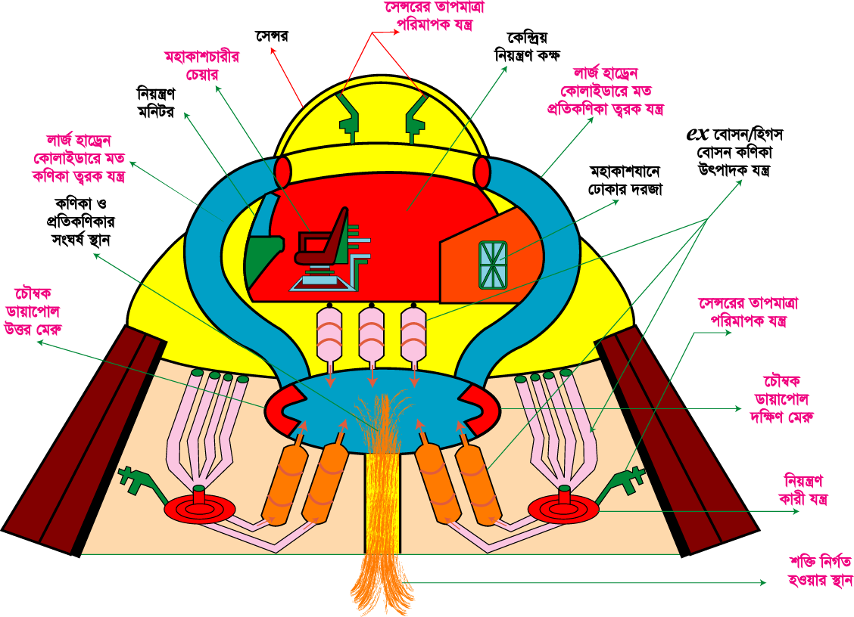
Chair
sensor
Central control room
Large Hadron Collider like particle acceleration instrument
Controlling monitor
ex Boson/Higgs Boson particle producing instrument
Large Hadron Collider like particle acceleration instrument
Entrance Door
Anti particle’s collision place
Magnetic Dipole ‘s
North pole
Sensor Temperature measurement instrument
Magnetic Dipole’s
South pole
Control machine
Energy emitting place

Slide 3
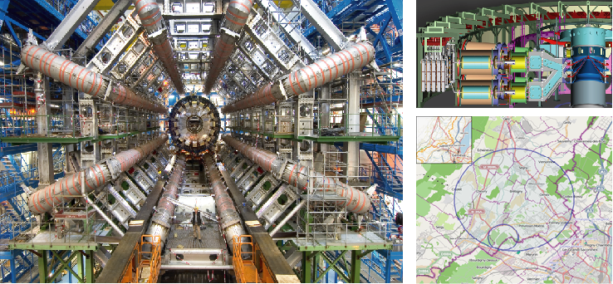

Slide 4
Energy Production system

Slide 5
1st Step

Slide 6
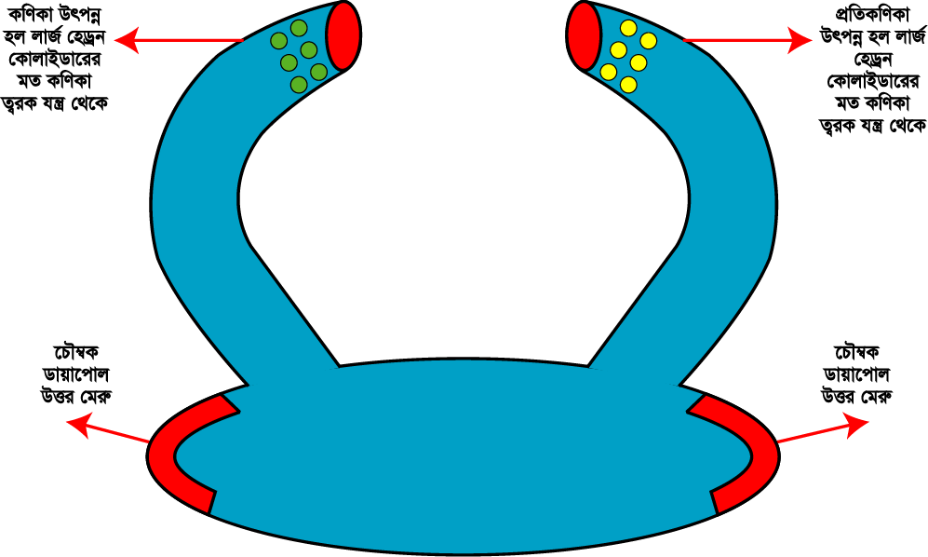
Produced particles by Large Hadron Collider like acceleration instrument
Produced anti particles by Large Hadron Collider like acceleration instrument
Magnetic Dipole’s
South pole
Magnetic Dipole ‘s
North pole

Slide 7
2nd Step

Slide 8
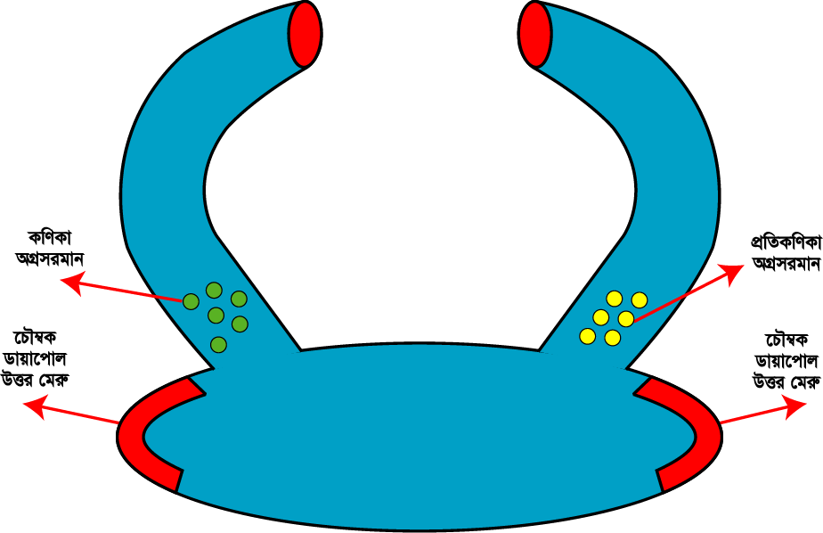
Moving forward anti particle
Moving forward particle
Magnetic Dipole ‘s
North pole
Magnetic Dipole’s
South pole

Slide 9
3rd Step

Slide 10
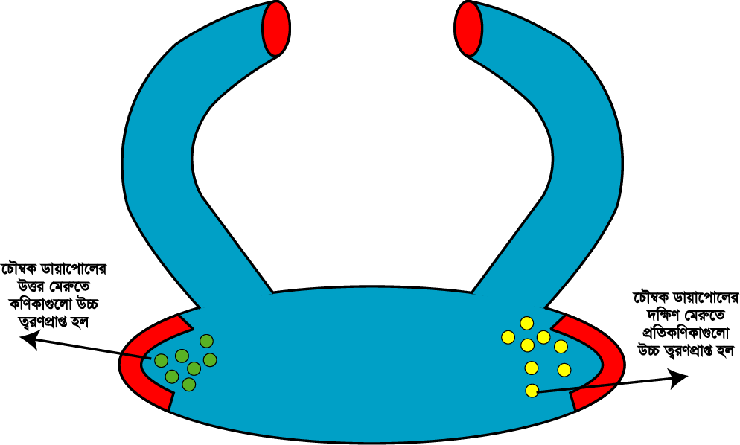
particles were highly accelerated in the magnetic dipole’s north pole
Anti particles were highly accelerated in the magnetic dipole’s south pole

Slide 11
4th Step

Slide 12
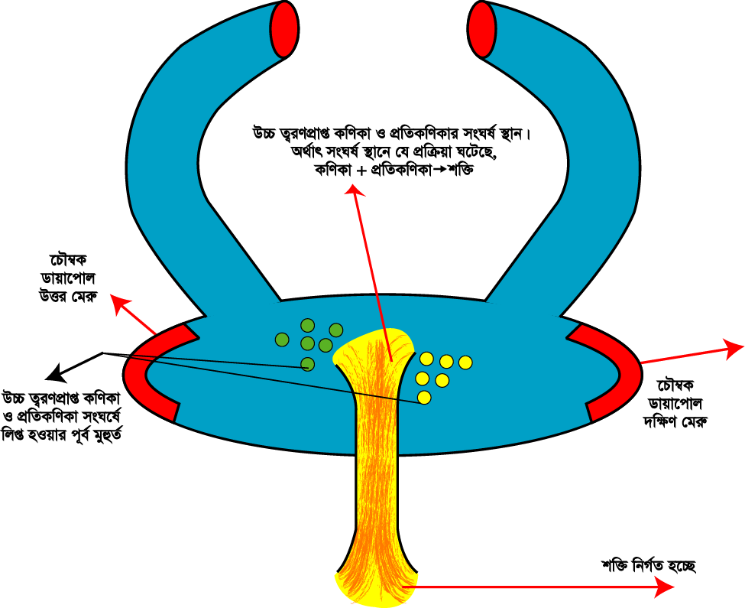
Highly accelerated particle and anti particle collusion place.
Reaction: Particle + Anti particle= Energy
Magnetic Dipole ‘s
North pole
Magnetic Dipole’s
South pole
Highly accelerated particle and anti particle’s pre collusion period
Emitting energy

Slide 13
5th Step

Slide 14
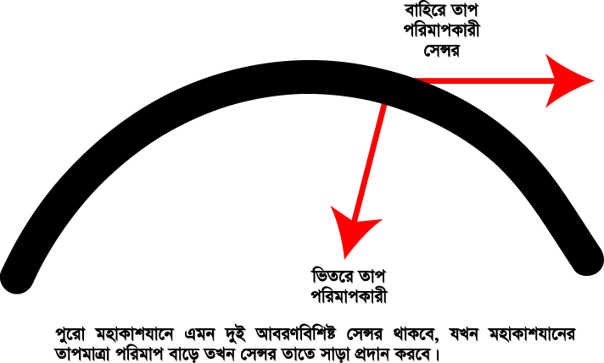
External temperature measurement sensor
Inner temperature measurement sensor
The whole shuttle will have this type of bi-layer sensor, when shuttle temperature will increase the sensor will react instantly

Slide 15
6th Step

Slide 16
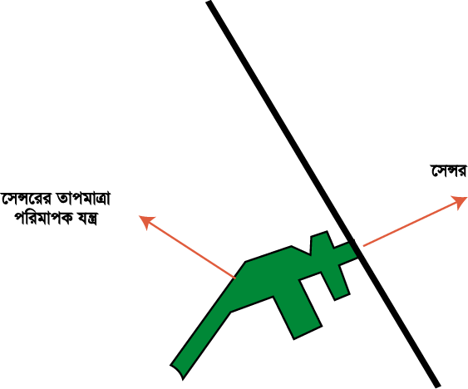
sensor
Sensors temperature measurement instrument

Slide 17
7th Step

Slide 18
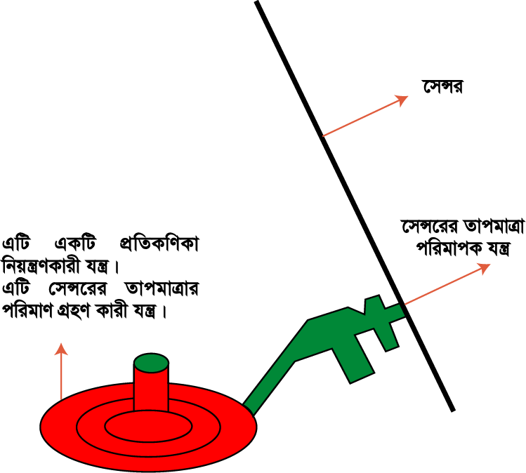
sensor
Sensor Temperature measurement instrument
This is an anti particle controlling instrument.
It measures Temperature of sensor.

Slide 19
8th Step

Slide 20
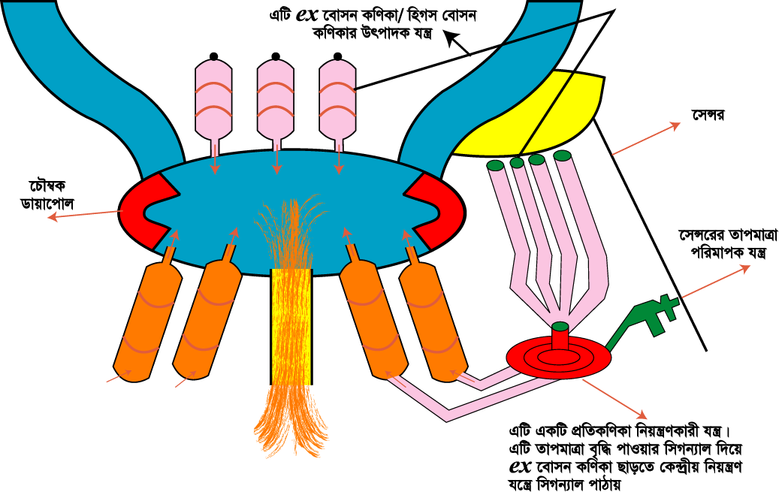
ex Boson/Higgs Boson particle producing instrument
Sensor
Magnetic Dipole
Sensor Temperature measurement instrument
An anti particle controlling instrument.
When the temperature is increased it gives signals to the central controlling instrument to release ex Boson particles

Slide 21
9th Step

Slide 22
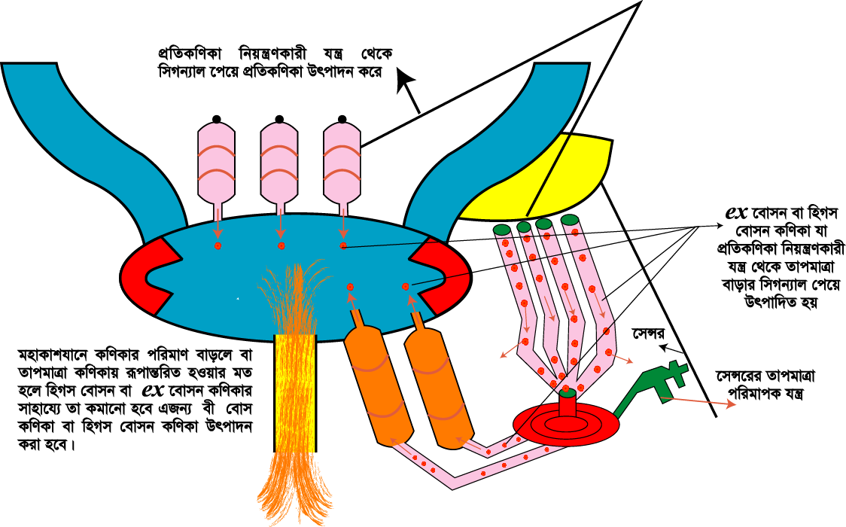
anti particle producing after getting signals from the anti particle controlling instrument
Produced ex Boson or Higgs Boson particle. Which is produced after getting the signal of increasing temperature from the anti particle controlling instrument.
sensor
Sensor Temperature measurement instrument

Slide 23
10th Step

Slide 24
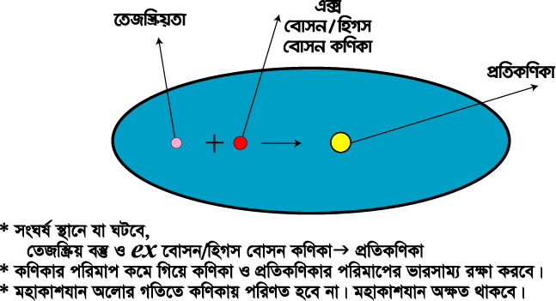
ex Boson/Higgs Boson particle producing instrument
Radio activity
Anti particle

Slide 25
Glory and Benefits

Slide 26
1.It can travel to alpha century approximately in 13 years
2.It can travel to Trappist-1e and Trappist-1f in 120 years
3.It has a technology like Voyager which contains languages, history of human, music, books and sounds of different species. So that if there’s any high intellectual animals, there’s a chance that they can contact with earth.

Slide 27
4.The process of producing energy will inspire us to create perpetual motion machine.
5.If it can travel back to earth, it may travel in future.
6.It will inspire future generation to invent something like time travel machine.
7.If earth will destroy we can take shelter in habitable exo-planet which will explored by our space shuttle.

Slide 28

GROUP-EXPLORER’S

Slide 29


GROUP MEMBER’S
SHABIK ZAHEER
MD. ASHIK ALI MURAD
ZARIN RAFA PRAPTI
TASNIA TAHSIN
ARNIKA TABASSUM ARNI
SELIBIS SARKAR TESTY

